Slide 1
Group 4 Record Linkage Comparison Patterns Match or Non-Match Project
Xiangming Kong: xk467 5424562 Contributed
Yongheng Hou: yh790 5556661 Contributed
Jie Wu: jw154 5555450 Contributed
Changzhou Bao: cb769 5467238 Contributed

Slide 2
Record linkage: core technique of data aggregation in computer science! When and why do we need to link the records?
Different sourced data to start analysis.
Based on statistics for computer science.
Aggregate and judge same data in different places.
Discovery for matched
or linked data .
Generally:
Widely used in fields of official management
Individual and whole character predication

Slide 3

Task Definition And Case Review
Given the data, which are person records in a comparison pattern that has individual first names, last names, sex, dob and post codes to classify if the record matches or not
Input: name, sex, date of birth, post code
Output: match or non-match ???
Example:
DataA: Jimmon King, male, 89/09/01, Wollongong 2500
DataB: Jimmen King, Male, 1989-9-1, north Wollongong 2500
Task: Are these two records from one entity?
Match or Non-Match? How much of probability?
Yes! That’s it!

Slide 4
Data Pre-Processing
Noises
Outliers
Missing value
There are no visible Noises, and the information of the data set is within the acceptable range
Outliers were not significant, and the column values that could be evaluated were all between 0 and 1.
Missing values are the primary object of this data set, and this is done by deleting the row with the missing value. And delete the columns with too many missing values.

Slide 5
OVERALL TASK FLOW:
Dataset
Objective
Explorative
analysis
Data
clean
Achieved
Pre-
processing
the
task
Re-formatting
Shaped
Self-
Implement
Strength, weakness,
Result
ML
models
SPARK
TensorFlow
Result
discussion
Hypothesis
conclusion

Slide 6
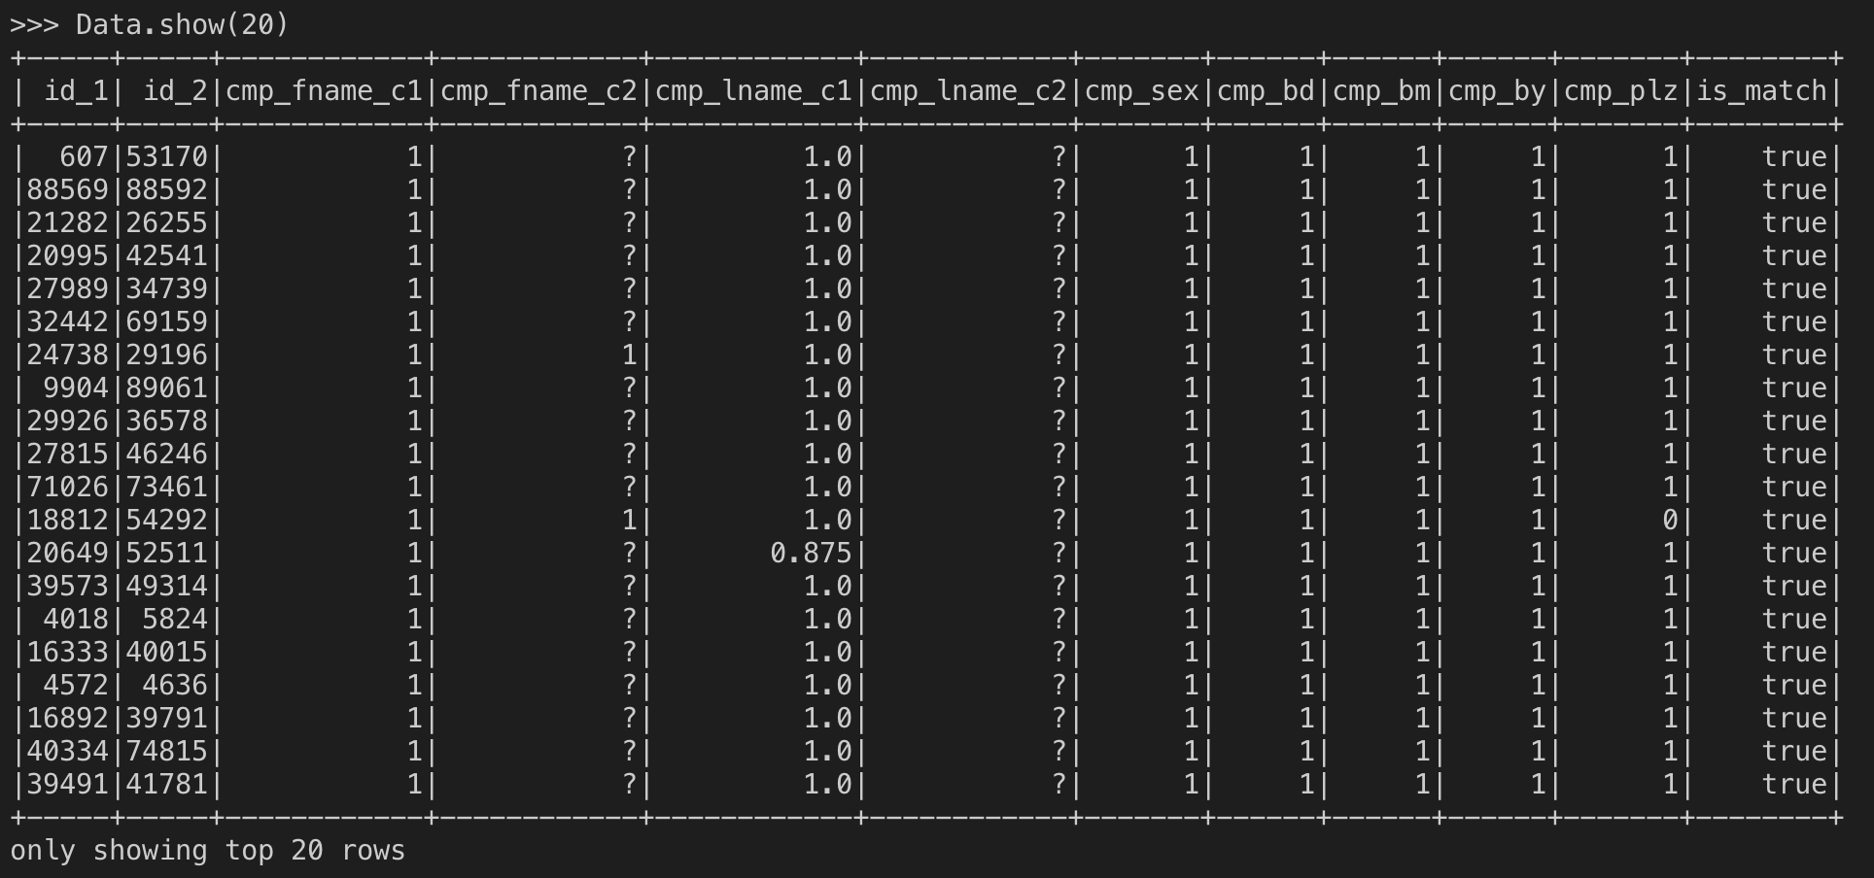
Closer look at the dataset

Slide 7
Implement approach introduction
Training
Focuses on self-implement, spark, tensorFlow approaches
Analysis
Result may differ
Focuses on the reason and back to data again

Slide 8
Data Pre-Processing
Noises
Outliers
Missing value
There are no visible Noises, and the information of the data set is within the acceptable range
Outliers were not significant, and the column values that could be evaluated were all between 0 and 1.
Missing values are the primary object of this data set, and this is done by deleting the row with the missing value. And delete the columns with too many missing values.

Slide 9
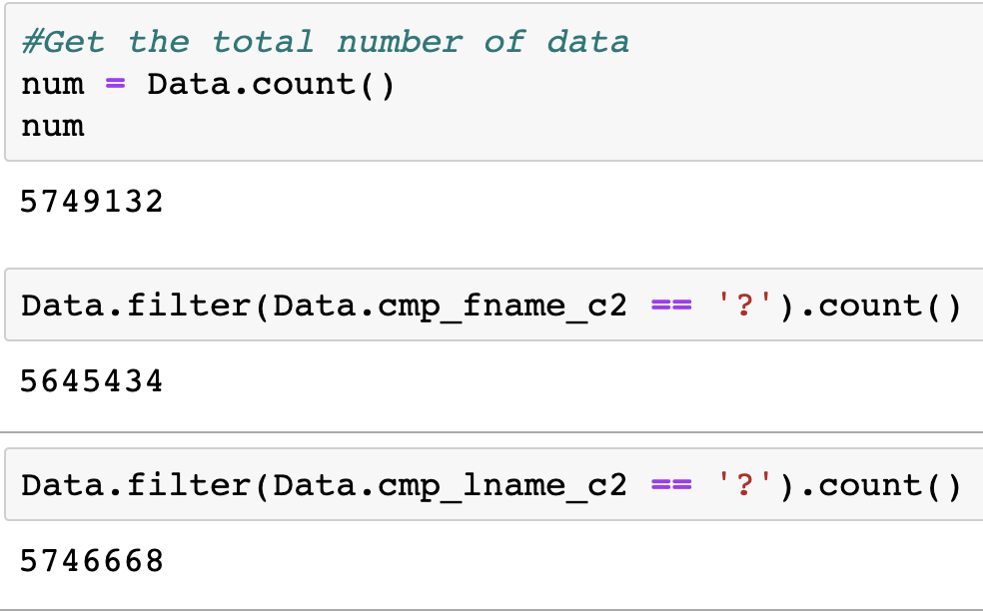
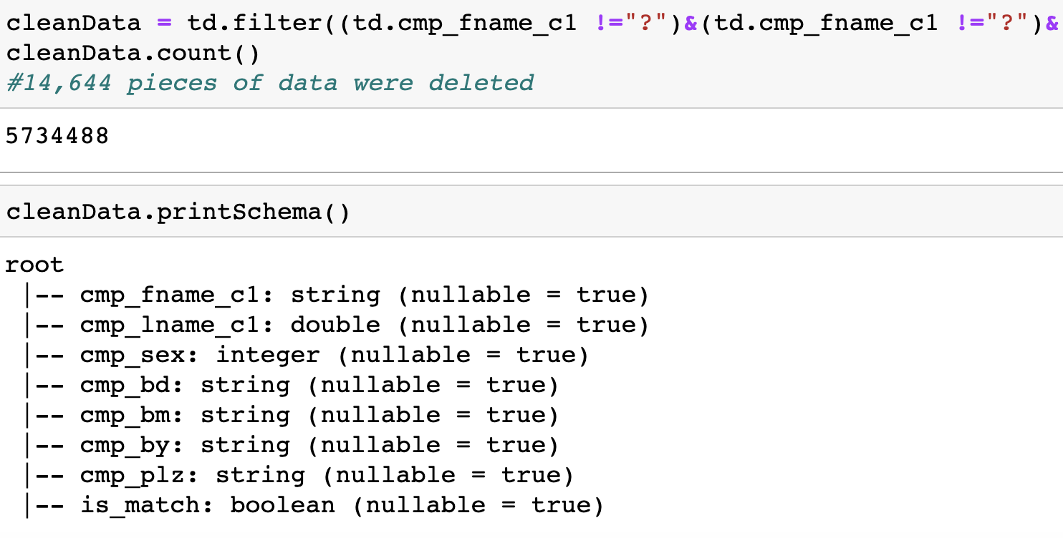
Data Pre-Processing
Removal of missing value

Slide 10
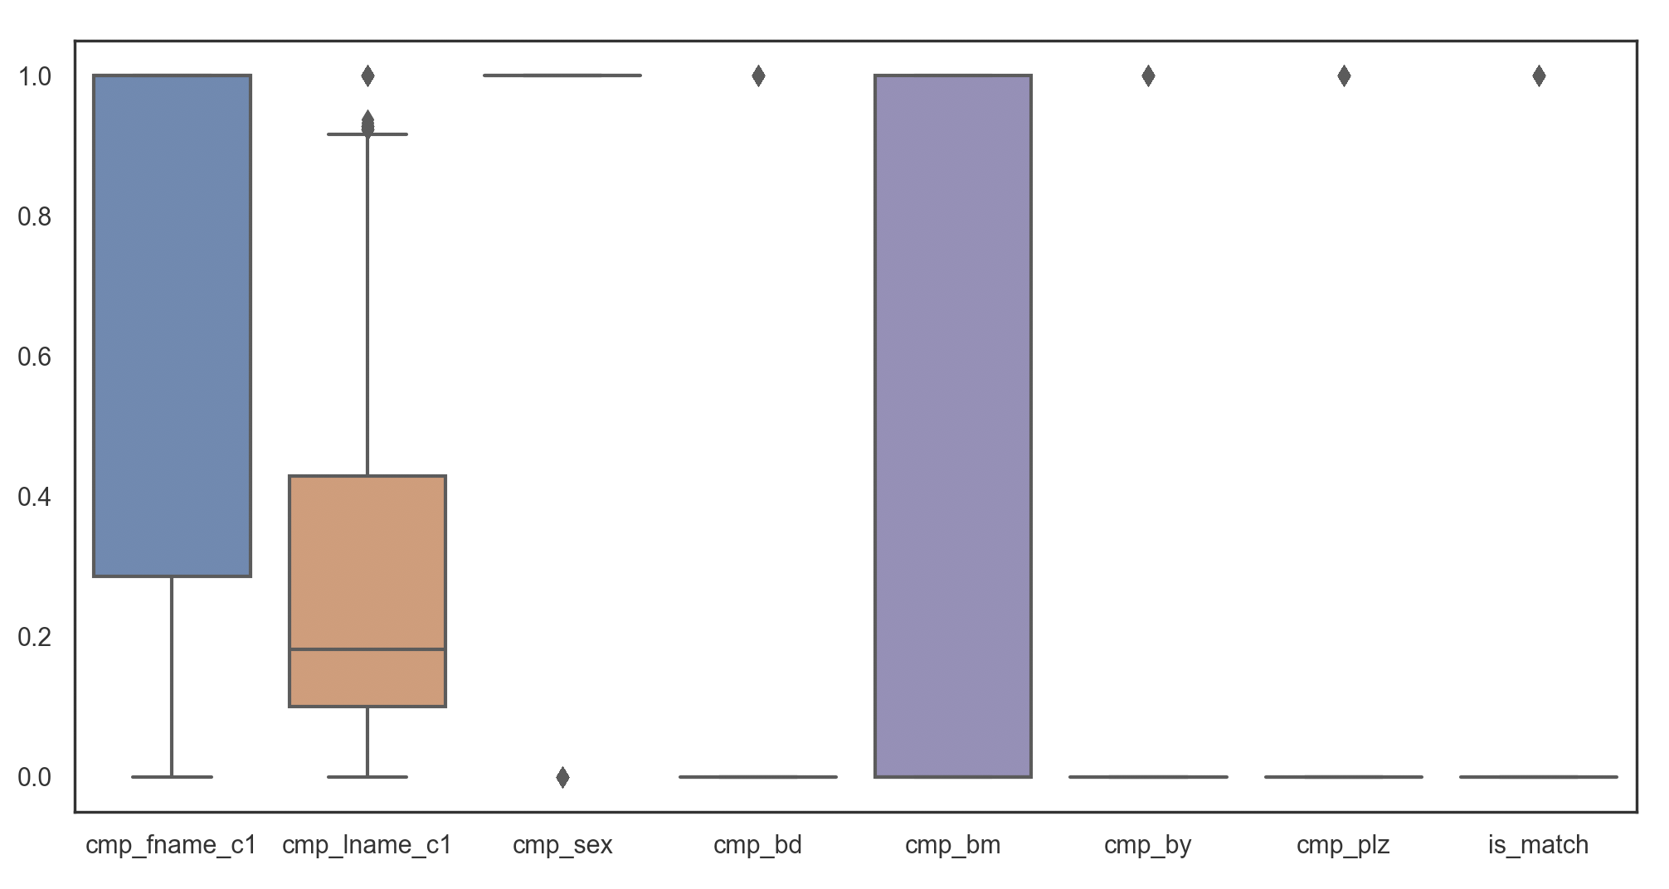
Visualisations of data
Box-Plot

Slide 11
Spark implement
Data type
Data structure
Data split

Slide 12
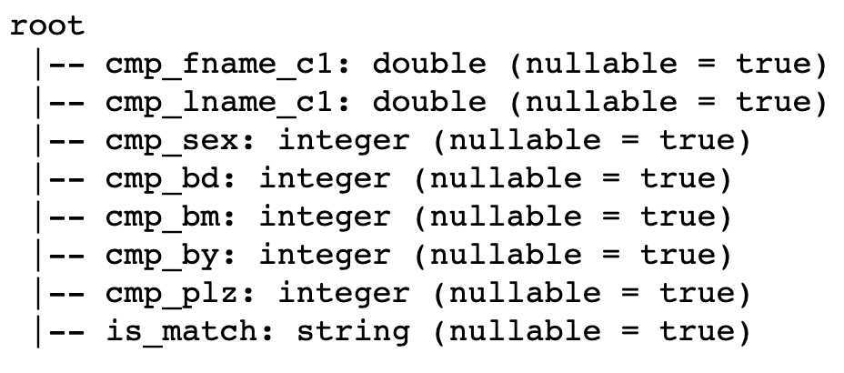
Data type The data type doesn‘t require features, but for Targets it has to be the type of ‘String’ in this data sets. Or ‘int’ , ‘double’ type form 0 or 1, never use ‘Boolean’ type.

Slide 13
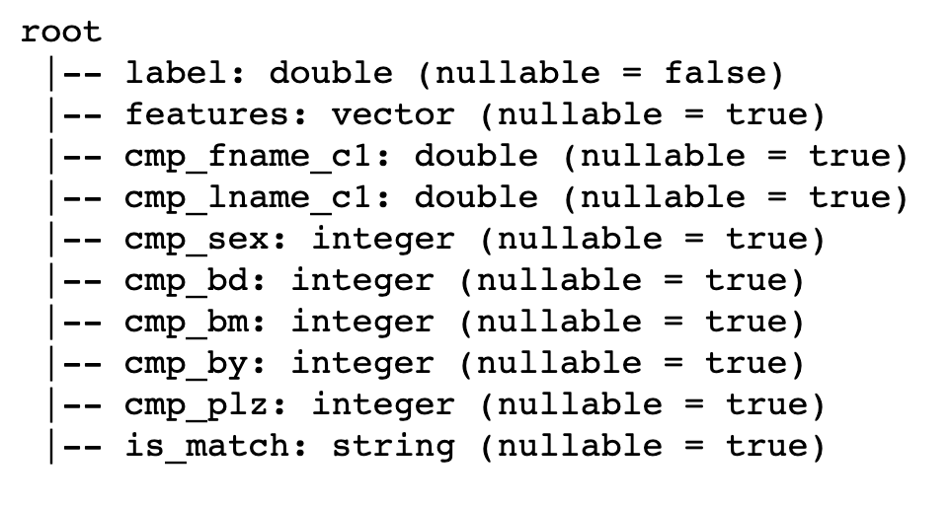
Data structure Two lines need to be added to the structure: features is an array of training values, vector type. label is the target of training, double type.

Slide 14
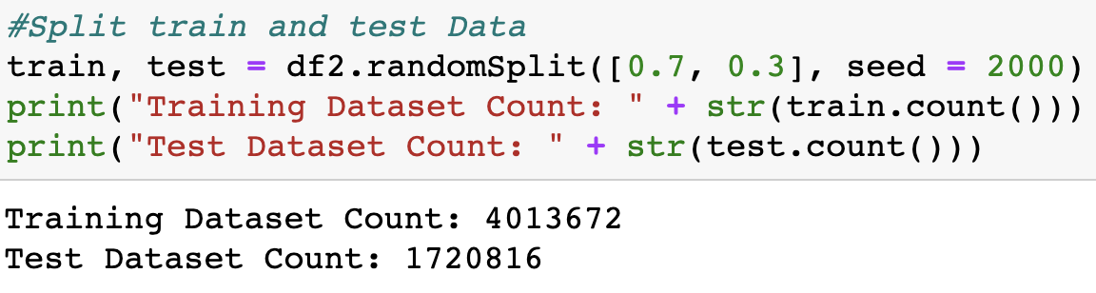
Data split Separate the training set from the test set by a ratio of 70% and 30%

Slide 15
Logistic Regression– Spark implement
Advantages
Disadvantages
Can be used for discrete data
Simple and easy to implement
The output value naturally falls between 0 and 1, and is probabilistic
ROC curve can be observed
Sensitive to missing value
When the feature space is large, the performance is not good
Because it's essentially a linear classifier, it can't handle correlations between features.

Slide 16
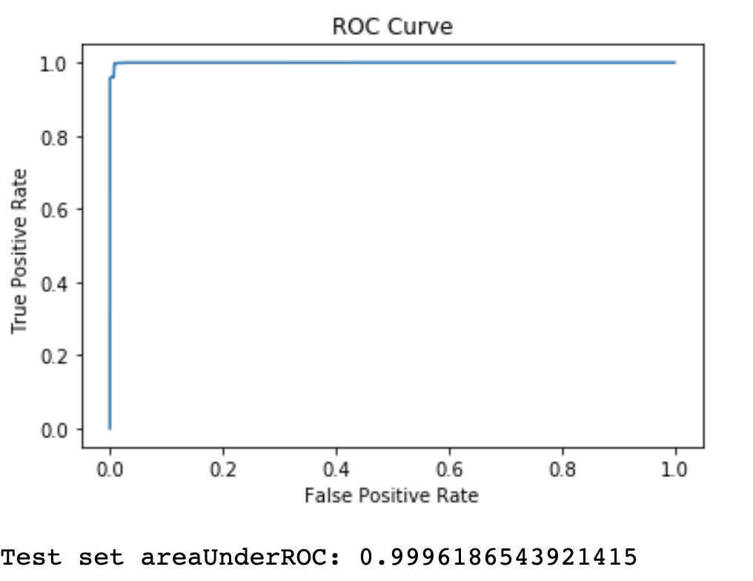
ROC：Too Good or just Right?

Slide 17
Why？
Reason 1:
We remove all outliers, missing values, and make our data set VERY clean.
Reason 2:
Our data set has been already WELL pre-processed, and now all of our data can be implemented to fit the pattern and match.

Slide 18
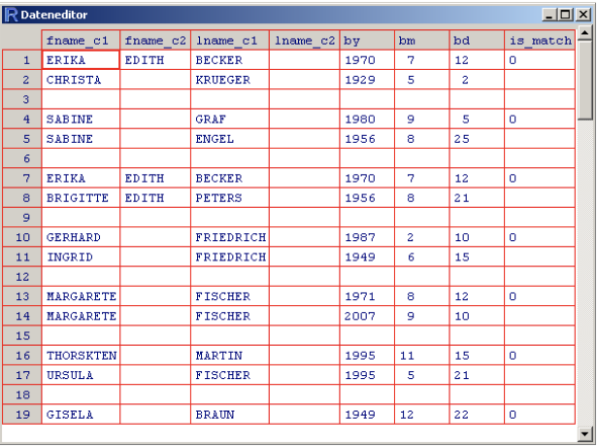
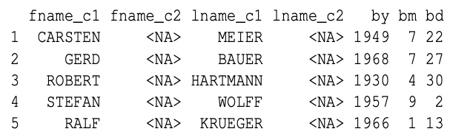
To compare from research:
The original data Krebsregister Data Set https://journal.r-project.org/archive/2010-2/RJournal_2010-2_Sariyar+Borg.pdf | Our data set Record Linkage Comparison Patterns Data Set

Slide 19
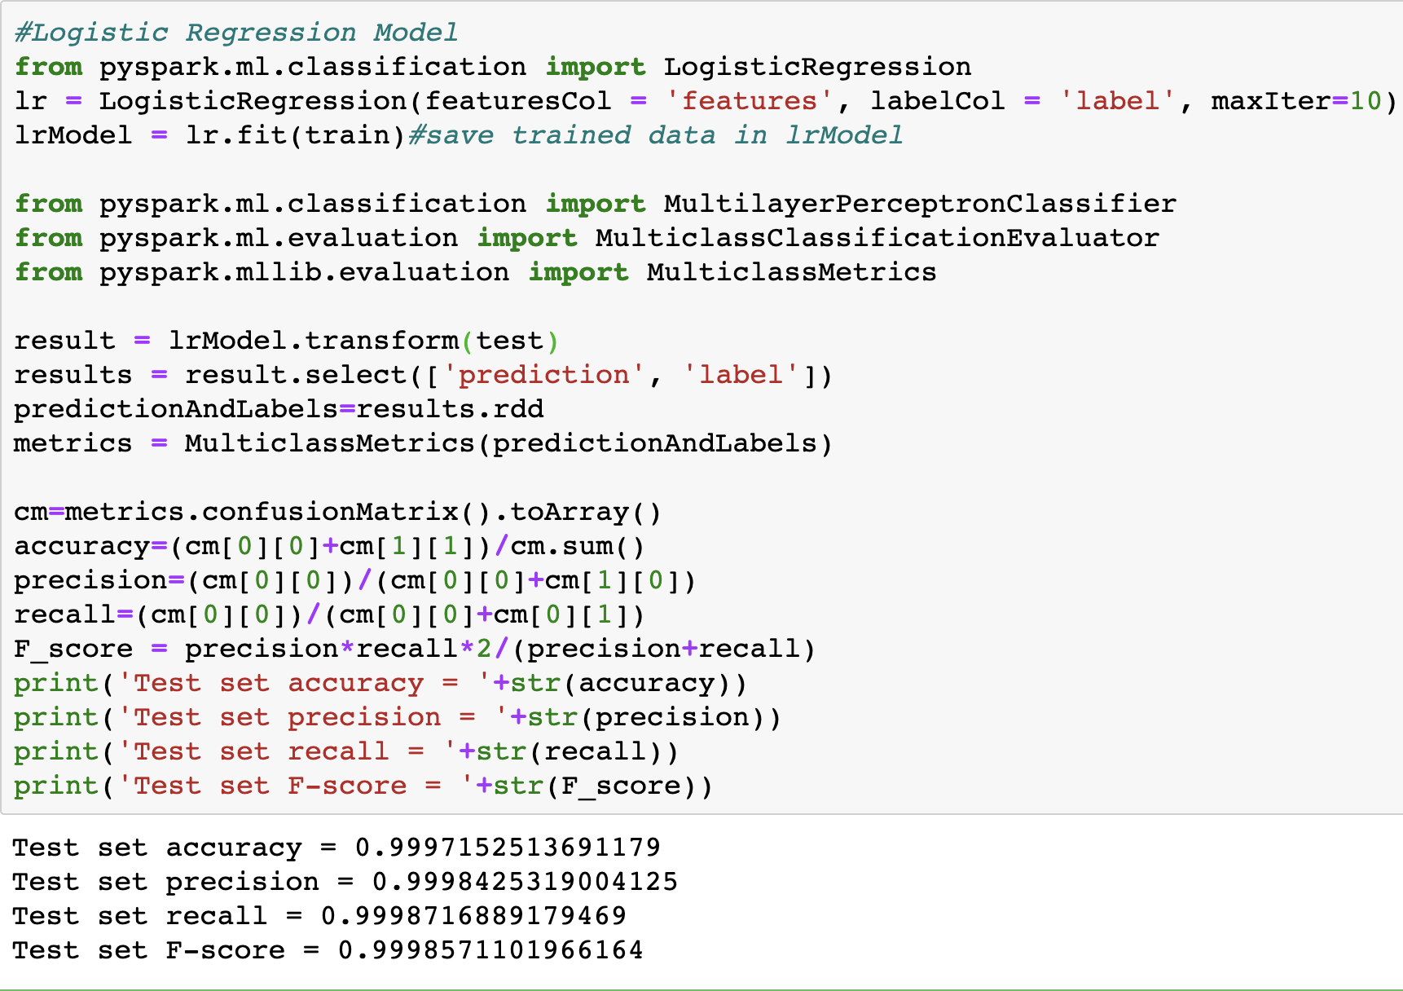
Logistic Regression

Slide 20
Decision Tree – Spark implement
Advantages
Disadvantages
Decision trees are easy to understand and interpret.
Ability to work with both data and category attributes
Capable of producing feasible and effective results for large data sources in a relatively short time
Difficulties in dealing with missing data in decision trees
For data with inconsistent number of different samples, the information gain results in the decision tree tend to be more numerical.

Slide 21
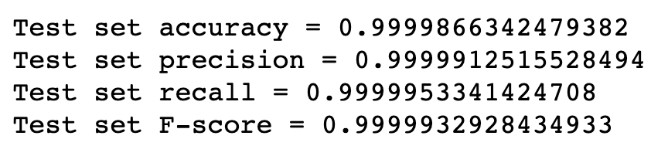
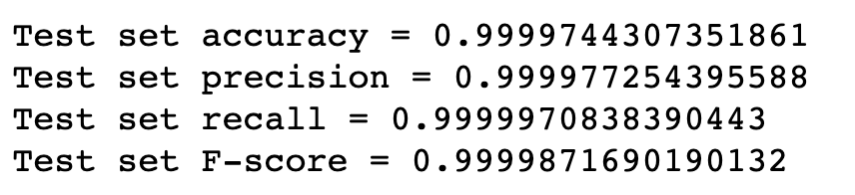
Decision Tree：
Random Forest：

Slide 22
Naive Bayes– Spark implement
Advantages
Disadvantages
Naive Bayes model has stable classification efficiency
Less sensitive to missing data, the algorithm is relatively simple and is often used for text classification.
Good performance on small scale data, able to handle multiple classification tasks, suitable for incremental training
Be sensitive to the presentation of input data
Since we determine the posterior probability through priors and data to determine the classification, the classification decision has a certain error rate

Slide 23
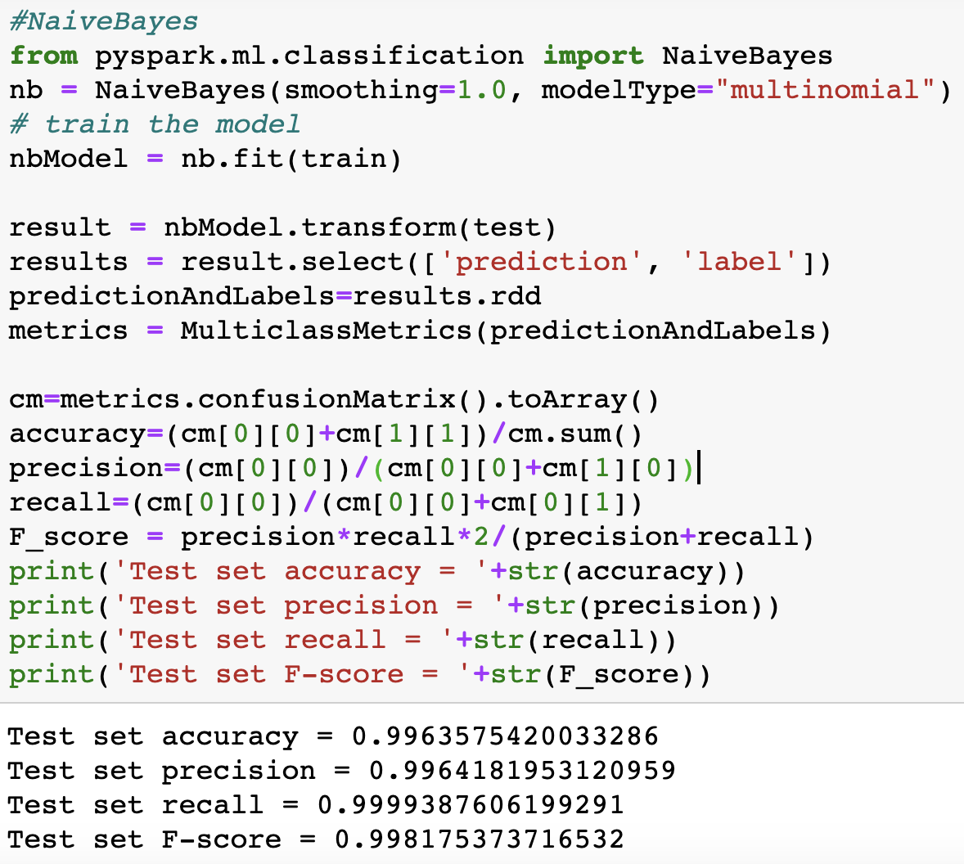
Naive Bayes ：

Slide 24

This stage are three classification models as this task is a classification problem
These models are Implemented from the scratch for three models, decision tree, random forests. Logistical regression.
In order to compare ,all implementations are basic version
This stage tends to focus on the theory of the model.

Slide 25
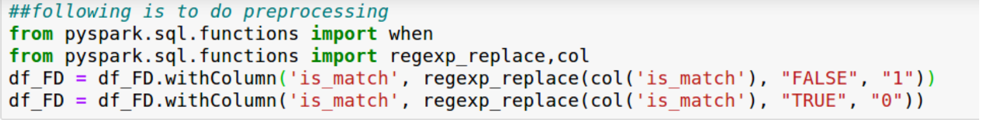
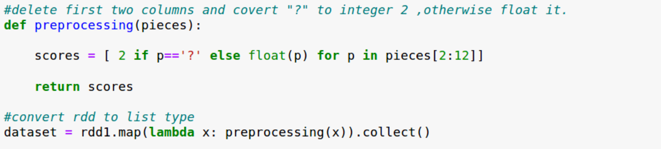
Data pre-processing for this stage

Slide 26
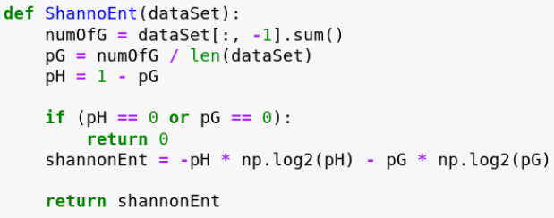
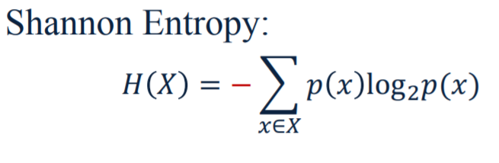
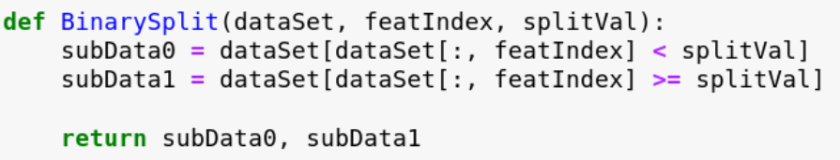
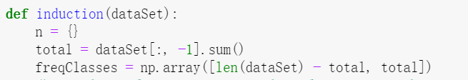
Implementation1-Decision tree
Entropy (information gain)
Binary split
Create Tree

Slide 27
Decision Tree – Result and Evaluation
cmp-By
V<1
V>1
False
cmp-fName-C2
V<1
V>1
ACC:0.9961594255836
PRE: 0.9961594255836
RECALL: 1.0
F1:0.998076018194175
cmp-fName-C1
False
V<0.4
V>0.4
False
True
Final Accuracy:
0.9961594255836

Slide 28
Decision Tree – Self-implement
Advantages
Disadvantages
Easy to understand, easy to explain
Easy for the visualization
The cost of using a decision tree to predict data is much less than training the decision tree
Decision tree is easy to overfitting
Small changes in the data can result in a completely different tree, so the one decision tree is not stable enough.
May use random forests as improvement in previous slides

Slide 29
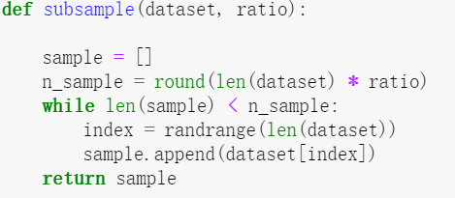
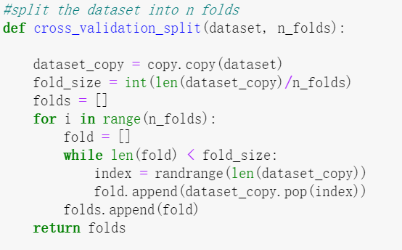
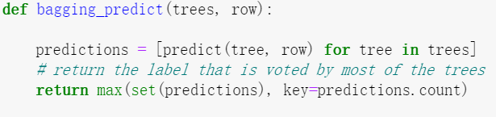
Implementation2-Random forests
Randomly selected features (column sampling)
Bagging
Random selection of samples (line sampling)
Voting

Slide 30

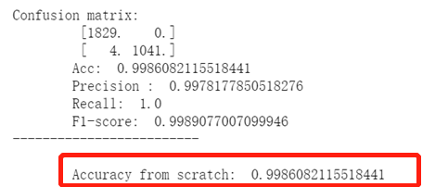
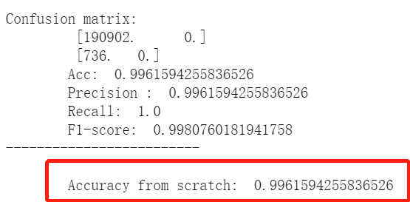
Random forests
Decision tree
In this case ,the accuracy of Random forests is higher than decision tree

Slide 31
Random forest – Self-implement
Advantages
Disadvantages
As we mentioned earlier a single decision tree tends to overfit the data. Random forests helps to overcome the problem of overfitting.
Random forests are extremely flexible and have very high accuracy.
As the characteristics of our data, italso maintains accuracy even when a large proportion of the data are missing
The disadvantage of Random forests is their complexity.
change one suitable model for binary classification

Slide 32
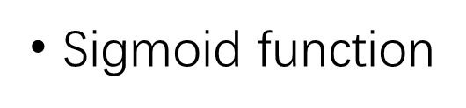

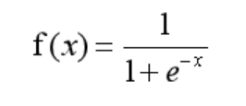
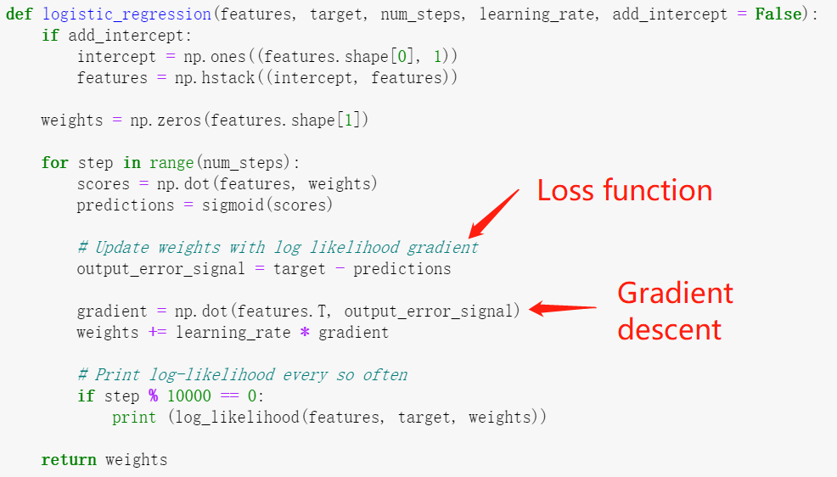
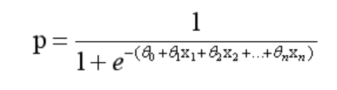

Implementation3-logistical regression

Slide 33
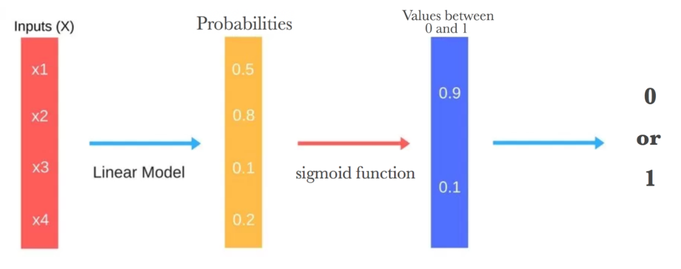
Flow Chart for explanation

Slide 34

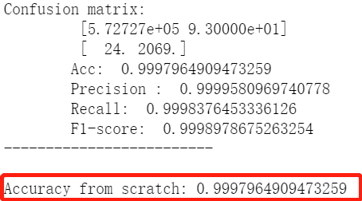
Evaluation -logistical regression
Decision tree:0.99615
In this case, the accuracy of Logistical regression model is higher than others
as improved!
Logistical regression:0.99979

Slide 35
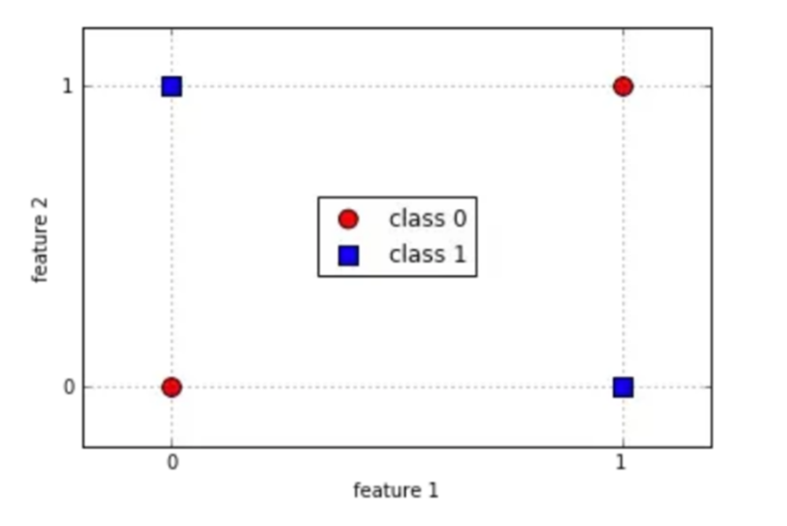
Logistic regression – Self-implement
Advantages
Disadvantages
Logistic Regression is the go-to method for binary classification, it has good performance on the binary classification.
Algorithm is easy
Sometimes it can’t solve complex
non-linear problems

Slide 36
Implement of Tensor Flow Keras – Neuron Networks
This stage are three models of neuron networks.
Implementation from the Keras for three models, DNN, RNN, CNN.
This stage is based on simulation from the theory of brain neuron with different layers for the task.

Slide 37
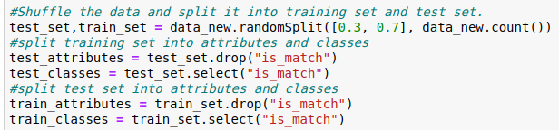
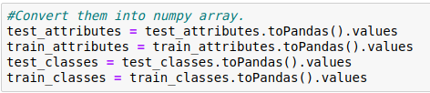
Data Transformation
Data preparation
After pre-processing, shuffle the data and split it into two which is the training set and the test set, the splitting ratio is 0.3 for the test set and 0.7 for the training set. After splitting the data, they have attributes and class in them, I need to divide them off.
Convert the data from data frame into NumPy array so that we can use them to train the models and evaluate the them.

Slide 38
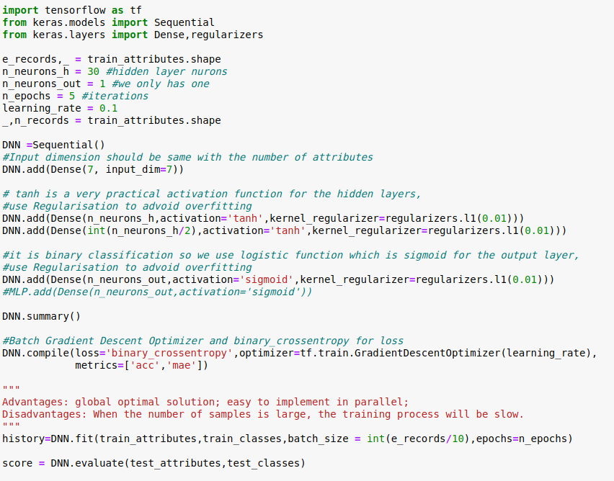

DNN model (i)
The model has an input layer and two dense layers which means fully connected.
Tanh activation function is more practical and stable compare to others.
DNN is easy to have overfitting problem so we use Regularisation to avoid it.
Mini-Batch Gradient Descent to reach minimum(easier to reach global minimum)

Slide 39
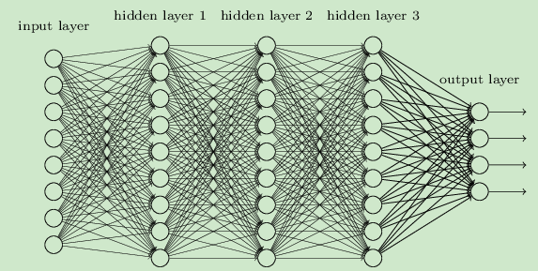
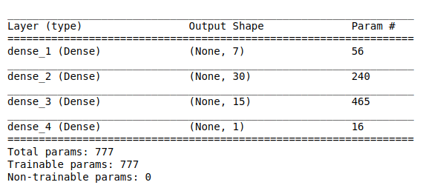
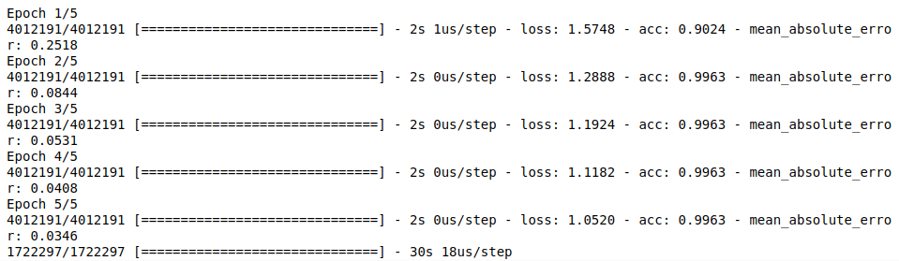
DNN model (ii)
The model has 4 layers which is an input layer(7 neuron), 2 hidden layers(30 neuron and 15 neuron) and an output layer (1 neuron)
5 training iterations, the accuracy didn’t change since the second iteration but the ‘mae’ and ‘loss’ decreased to very small.

Slide 40
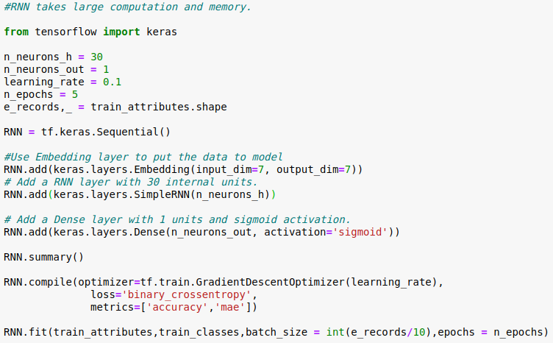
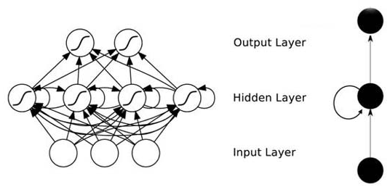
RNN model (i)
The structure of the RNN which I made is 1 Embedding layer, for putting the data into model, 1 Recurrent hidden Layers and 1 fully connected output layer.
Make the batch size smaller to prevent from Out Of Memory, RNN takes more memory than DNN

Slide 41
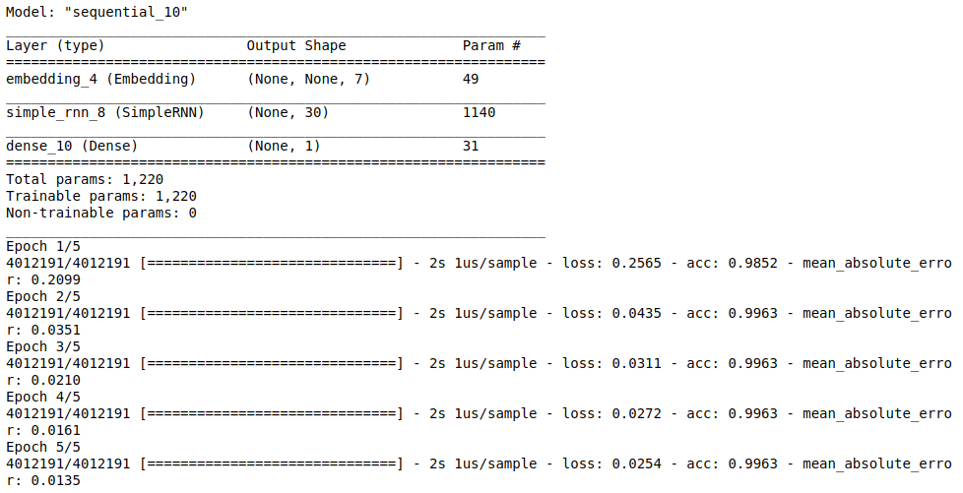
RNN model (ii)

Slide 42
CNN model (i)
Convolution layer is like an eye scanning an area
Max-pooling layer has two main functions:
Invariance, this invariance including translation, rotation, scale
Retain the main features while reducing parameters (dimension reduction, the effect similar to PCA) and calculations, preventing over-fitting and improving the model generalization ability
Before put the data to the dense layer, data need to be flattened

Slide 43
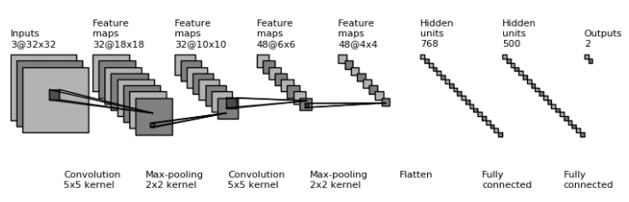
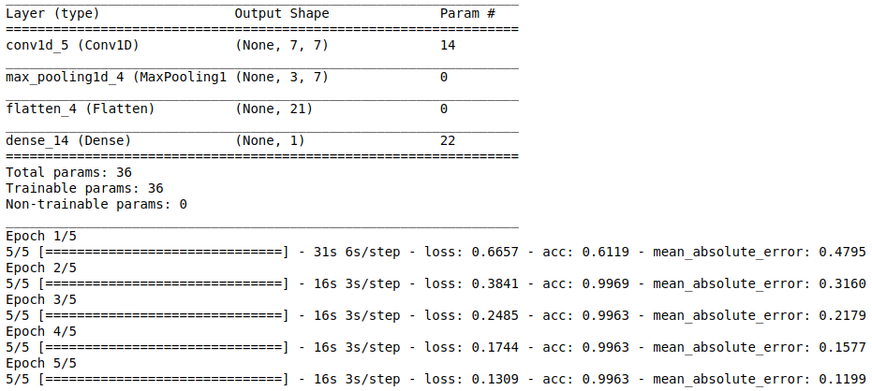
CNN model (ii)
Compared to our task, input the age, gender, net-time and time difference to predict the position seems to be more useful in big-data statistical issues.

Slide 44
Comparison for the models
CNN specifically solves the image problem and can use its own feature extraction layer on the input layer, and finally use MLP to classify.
RNN specifically solves the problem of time series, using extracted time-series information, placed after the feature extraction layer (such as CNN).
DNN
it is more concentrate on the number of layers.
Expansion of the number of parameters.
Overfitting
Easy to fall into local optimum

Slide 45
Issues and related scale overview
Self implement, spark and tensor flow are reasonably well in the case
Besides the models, blocking is also important
May be a quite popular in probabilistically match tool

Slide 46
Beside the given Dataset: Canada residential data project
Data collection from 1991 of residential addresses.
Data linkage to other aspects of data.
6% correction from more than 2050,000 in pre-process.
Record linkage reduces from 2050,000 to 670,000!
Hypothesis and similar issues : always welcome!

Slide 47
Result summary and related explanation
Quite good dataset and nice focused pre-processing, similar results in the end
Redundant (matched) records are apparently less than normal cases as the character of Data Volume
Real cases and implements are combined with human control too
Data volume and precision increases,
What about security scales?

Slide 48
Limitations related from the Case
Made for efficiency from the results
Right implement for official cases
Security concern raises after vague data record
CRIMINAL?
Same Data from One Entity
and
Semi Different Data but Actually One Entity?

Slide 49
Thank you for attending! Questions ?
Record linkage discovery LINKS to
data regulation and crime control!
Data science development LINKS to
Life improvement and success!

